Slide 1




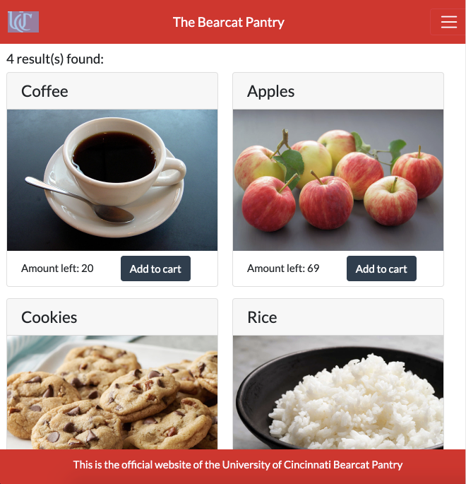






Problem
Bearcat Pantry
Broader Impact
Currently, the Bearcat Pantry manually keeps track of Student’s orders as well as their own Inventory. As a result, Students using this service must call in to learn what items are available at the pantry. The current system also requires that an advisor unlock the pantry in Stratford, then allowing Students to take whatever they want. There is a need for a new system to catalog and update the pantry’s inventory as well as display this inventory to users on a website. It should also allow users to use the pantry while remaining somewhat anonymous, and prevent the potential abuses related to an untracked inventory such as users taking more than they are allotted.
Making the pantry checkout systems more accessible to users increases the likelihood that those who need its resources most will have access to it.
Likewise, increasing the efficiency of the inventory management system means better use of volunteer time. Time spent manually tracking items can now be spent on improving other aspects of the pantry.
Developers
Challenges
Adam Kowalski
Christian Davidson
Andrew Kump
Will Severson
● Predicting edge cases to prevent unintended website behavior.
● Communicating between development team and university.
● Inexperience using MongoDB and JavaScript.
● Developing an effective user interface with minimal input from university.
● Effective time management with consideration of other college responsibilities
Advisor: Dr. Nan Niu
Accomplishments
Goals
● Working barcode scanning and inventory system.
● Paginated browse page for users to select items from pantry stock.
● Complete email verification system that sends an email once
checkout has completed on the shopping cart page.
● Added admin tools, such as editing of existing items, which are
visible only when logged in as admin.
● Implemented robust suite of regression tests to aid in preventing
and debugging future defects.
● Create a page for UC students to securely login to the new pantry website.
● Implement an inventory system to track item stock using barcodes and item names.
● Develop a shopping cart system where students can add items to their unique shopping cart which they can then checkout.
● Design a system to email users as well as pantry volunteers upon completion of an order. The email to volunteers should contain a QR code which can be scanned to verify an orders information. The email to pantry users should support the addition of links to pantry surveys.

